Slide 1
Route 53

Slide 2
What is DNS?
DNS is nothing but Domain name system.
It helps resolve Domain name to IP address.
This works on port number 53, hence this DNS related service which is provided by Amazon is called as Route 53.
The Domain Name System is the hierarchical and decentralized naming system used to identify computers, services, and other resources reachable through the internet or other internet protocol networks.
The resource records contained in the DNS associate domain names with other forms of information

Slide 3
Route 53
Route 53 is a service provided by amazon with the help of which we can register new domains, transfer existing domains, route traffic to your aws resources and also we can monitor health of our resources.
Route 53 serves main 4 functions:-
A. DNS management
B. Traffic Management
C. Availability monitoring
D. Domain registration

Slide 4
Domain registration
Here we can create and register our own domains.
This is not free and the price of the domains depends upon what type of domain we are taking, .com, .net, .org etc.
Here the domain which we are trying to create or register should be available.
Route 53 also acts as a registrar.
A registrar is where website are registered. Other registrar examples are godaddy.com etc.
A registrar also tells us that whether the domain is available or not, and also gives us other options.

Slide 5
DNS management and health check
One of the major use of route 53 is DNS management.
It helps route traffic to the resources for your domain, also the domain can be inside our AWS account or outside with any other registrar.
route 53 sends automated request to our resources over the internet to a resource to verify that the server is reachable or not.
You can also choose to receive notifications when a resource becomes unavailable and choose to route traffic away from unhealthy resources.

Slide 6
Traffic management
When it comes to traffic management to our DNS there are various policies which we can attach.
Easy-to-use and cost-effective global traffic management: route end users to the best endpoint for your application based on geo proximity, latency, health, and other considerations.
Route 53 Traffic Flow allows an AWS customer to control traffic routes using a drag-and-drop graphical user interface to ease traffic management.
Route 53 Traffic Flow also enables a user to revert to previous traffic routing policies.

Slide 7
Some important concepts of Route 53
Hosted zones
Name servers
Records and types of record sets

Slide 8
Hosted zones
A hosted zone is an Amazon Route 53 concept.
A hosted zone is traditional DNS zone file; it represents a collection of records that can be managed together, belonging to a single parent domain name.
Basically a hosted zone is a container that holds information about how we want to route traffic for a domain and a subdomain.
When we buy a domain from AWS we don’t need to create a hosted zone and name servers everything is created automatically.
There are 2 types of hosted zones, public and private.

Slide 9
Name servers
Nameservers help connect URLs with the IP address of web servers. Nameservers are an important part of the Domain Name System (DNS), which many people call the “phone book of the Internet”.
Usually we have 4 name servers which will have all the server info, for each hosted zone and they will be unique to the account.
When someone uses the browser to access our website these name servers inform the browser where to find our resources.

Slide 10
records
DNS records are instructions that live in authoritative DNS servers and provide information about a domain including what IP address is associated with that domain and how to handle requests for that domain.
Name server records identifies the 4 name servers that you give to your registrar on your DNS service so that DNS is routed to route 53 name server.
SOA – every single hosted zone has one and only one SOA (start of authority record) at the beginning of the zone.
This is not an actual record it just holds the info of who the owner is and its email.

Slide 11
Supported DNS record types by route 53
A record:- this is a address record which maps domain name to ipv4 address. This is 32 bit
AAAA records:- this is for DNS to IPV6 mapping, its 128 bit.
CNAME – canonical name records, means maps alias to a hostname.
NS record – name server record.
SOA record – Start of Authority.
MX record – for mail exchange defines where to deliver email eg mail@velocity.com

Slide 12
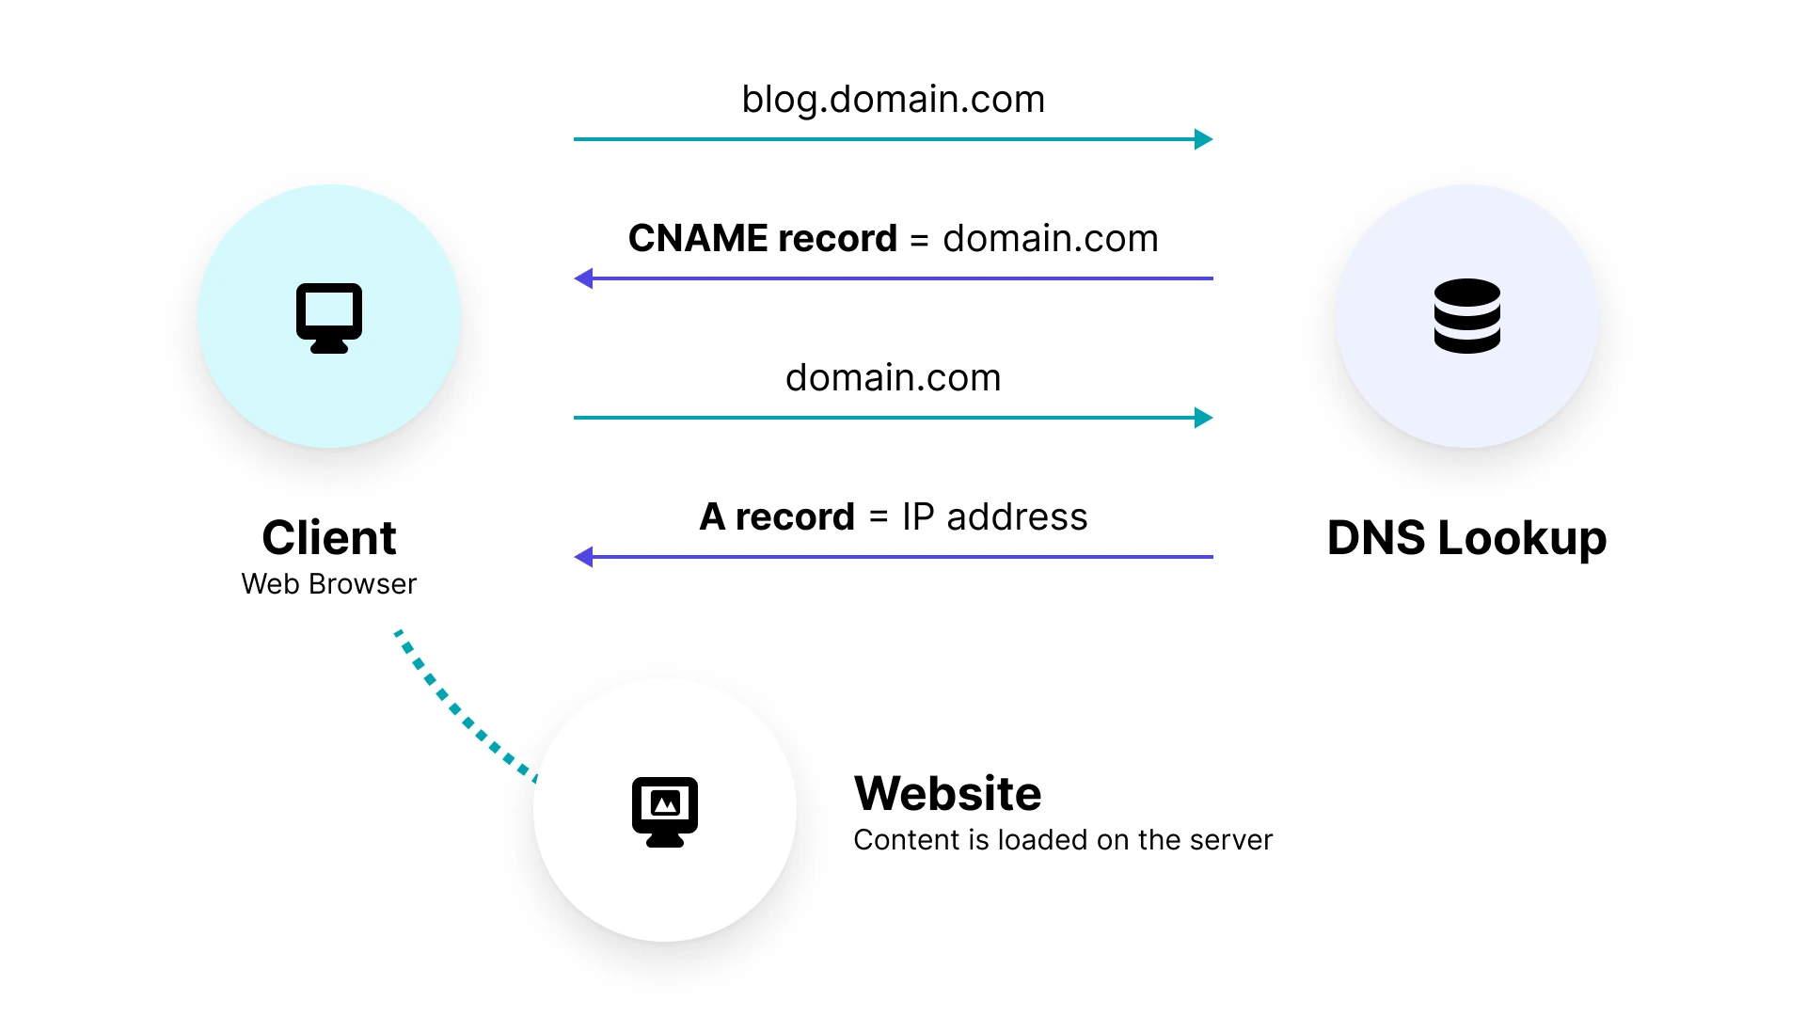
Cname
CNAME is a alternative record or it acts as a alias for another records, this is helpful in redirection or if you want to hide details about your actual server from the user.

Slide 13
Traffic management policies
Simple Routing Policy
Failover
Weighted
Geolocation
Geo-proximity
Latency

Slide 14
Simple routing Policy
Simple routing lets you configure standard DNS records, with no special Route 53 routing.
With simple routing, you typically route traffic to a single resource, for example, to a web server for your website.

Slide 15
Failover
Failover Routing Policy is used to create Active/Passive set-up such that one of the site is active and serve all the traffic while the other Disaster Recover (DR) site remains on the standby.
Route 53 monitors the health of the primary site using the health check.
Failover routing lets you route traffic to a resource when the resource is healthy or to a different resource when the first resource is unhealthy.

Slide 16
Weighted policy
With the help of weighted we can control what % of requests can go to specific endpoints.
This is useful if you want to test a new version of application with only 10% if the actual load.
Also helpful to split traffic between 2 regions.
Can be associated with health checks

Slide 17
others
Latency Routing Policy is used when there are multiple resources for the same functionality and you want Route 53 to respond to DNS queries with answers that provide the best latency i.e. the region that will give the fastest response time.
Geolocation routing policy – Use when you want to route traffic based on the location of your users. Cannot control the coverage size from which traffic is routed to your instance
Geo-proximity routing policy – Route traffic to specific instances based on the location of the instances and the users. Specify a bias to control the size of the geographic region from which traffic is routed to your instance.

